Slide 1



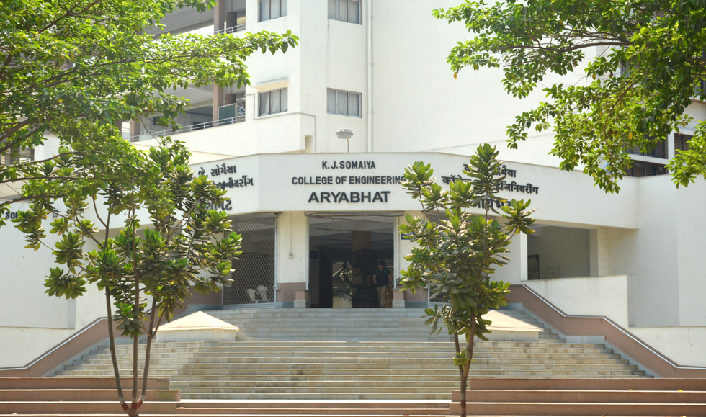
Humidity Prediction for Ghatkopar Area by Time Series
16010123012- Aaryan Sharma
16010123023- Aditya Baheti
16010123037- Ambuj Rai

Slide 2
Problem Statement
Accurate humidity prediction is essential for weather forecasting, agriculture, and city management.
However, reliable forecasting faces several challenges:
Seasonal Fluctuations: Mumbai’s monsoon and coastal effects cause large humidity variations.
Data Irregularities: Missing or inconsistent weather data complicates model training.
Model Accuracy: Capturing both trend and seasonality without overfitting is difficult.
Goal:
Develop an optimized ARIMA/SARIMA-based model to predict daily humidity for Ghatkopar (2023–2024).

Slide 3
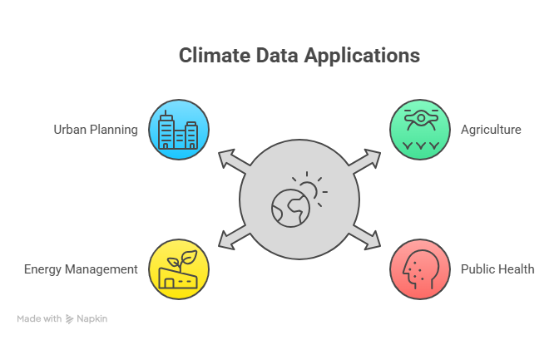
Why Humidity Forecasting Matters
Agriculture: Supports irrigation planning and crop protection.
Public Health: Helps forecast conditions favorable for heat stress and disease spread.
Energy Management: Aids HVAC load optimization and energy efficiency.
Urban Planning: Enables preventive maintenance for humidity-sensitive infrastructure.

Slide 4

Study Area: Ghatkopar, Mumbai
Location: 19.0860° N, 72.9090° E
Climate Zone: Coastal tropical monsoon
Data Period: January 2023 – December 2024
Data Source: Open-Meteo Archive API
Resolution: Daily average humidity (%)
High humidity (85–95%) during monsoon
Moderate levels (60–75%) in winter and post-monsoon
Clear seasonal cycles ideal for time series modeling

Slide 5
Data Collection & Characterization
Source: Open-Meteo Historical Weather API
Records: 731 daily observations (2023–2024)
Variables: Date, Relative Humidity (%)
Quality Checks:
Forward-fill for <1% missing values
Sorted chronologically for stationarity
Validated humidity ranges (45–95%)

Slide 6
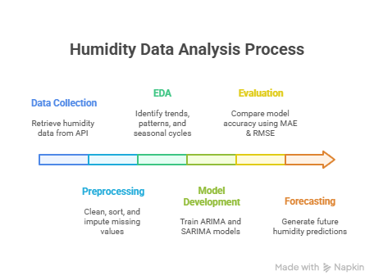
Methodology: End-to-End Pipeline
Data Collection – Retrieve humidity data from API
Preprocessing – Clean, sort, and impute missing values
EDA – Identify trends, patterns, and seasonal cycles
Model Development – Train ARIMA and SARIMA models
Evaluation – Compare model accuracy using MAE & RMSE
Forecasting – Generate future humidity predictions

Slide 7
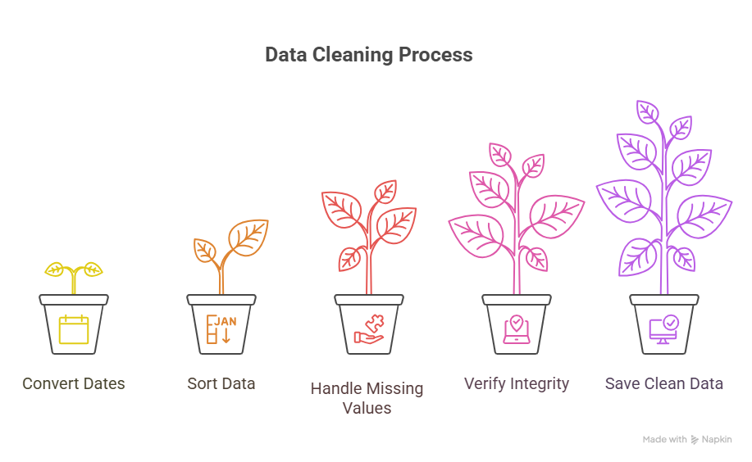
Data Preprocessing
Converted date strings to datetime objects
Sorted data in chronological order
Handled missing values with forward-fill
Verified data integrity through range checks
Saved clean dataset for modeling

Slide 8
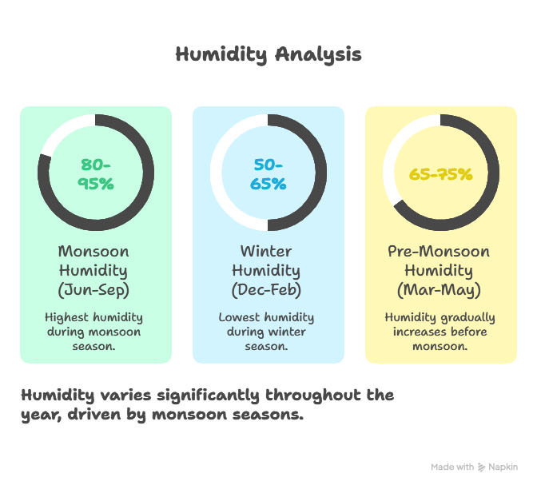
Exploratory Data Analysis (EDA)
Temporal Analysis:
Detected strong seasonal cycles with monsoon peaks.
Stable year-to-year humidity patterns.
Monthly Analysis:
Monsoon (Jun–Sep): 80–95% humidity
Winter (Dec–Feb): 50–65%
Pre-Monsoon (Mar–May): Gradual increase from 65–75%

Slide 9
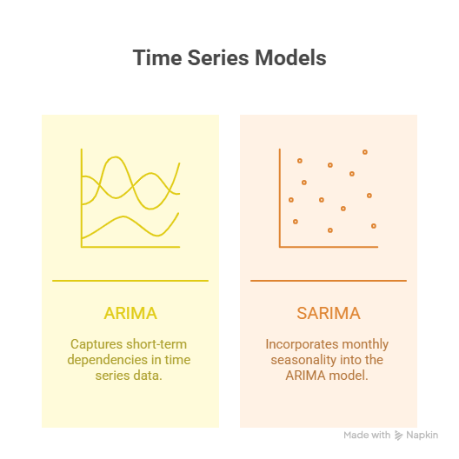
Model Development
Models Implemented:
ARIMA (Auto-Regressive Integrated Moving Average): Captures short-term dependencies.
SARIMA (Seasonal ARIMA): Incorporates monthly seasonality (m = 12).
Parameter Optimization:
Grid search over (p, d, q) and seasonal (P, D, Q, m)
Based on AIC values to balance fit and complexity.

Slide 10
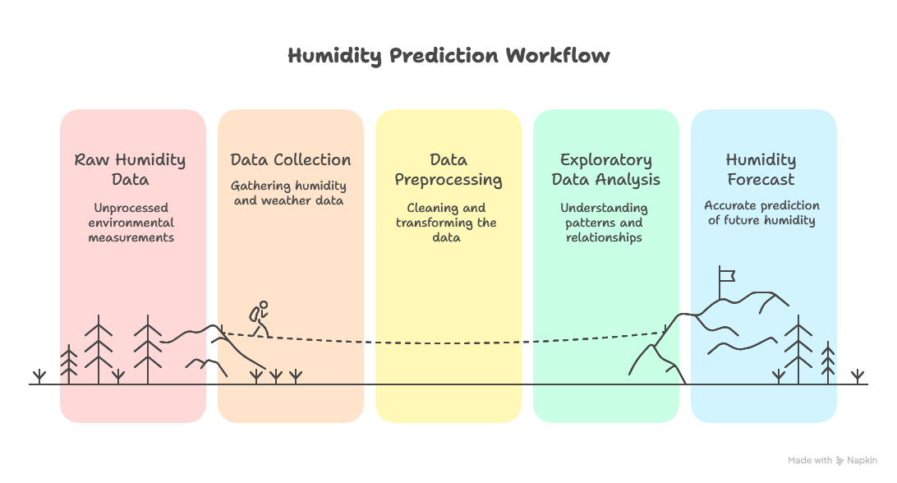
Block Diagram

Slide 11

Evaluation Metrics
Performance Indicators:
MAE (Mean Absolute Error): Average absolute difference between predicted & actual values.
RMSE (Root Mean Square Error): Penalizes large deviations; sensitive to outliers.
These metrics allow model comparison in original (% humidity) units.

Slide 12
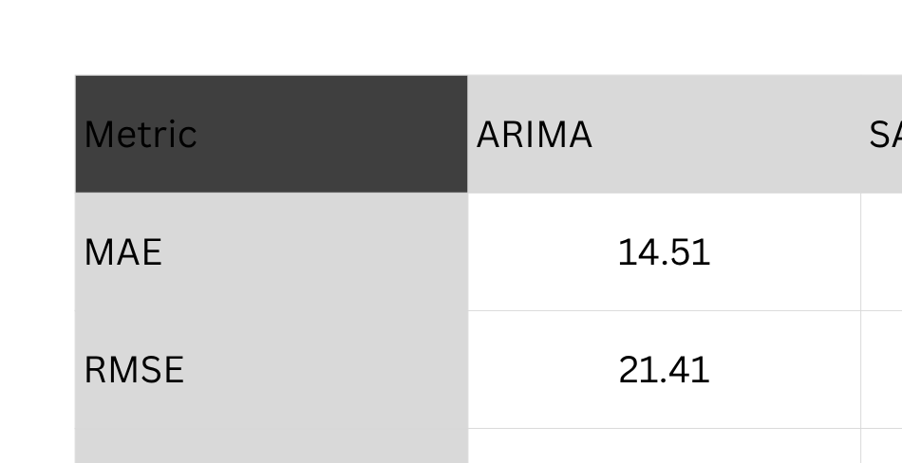
Model Comparison Results
Conclusion: SARIMA achieved better accuracy in capturing seasonal patterns.

Slide 13
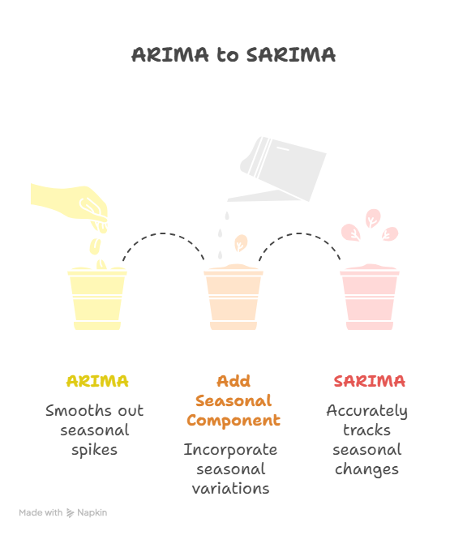
Forecast Visualization
ARIMA predictions follow overall trend but smooth out seasonal spikes.
SARIMA forecasts closely track real seasonal variations.
Peak humidity during monsoon and drop during winter accurately captured.

Slide 14
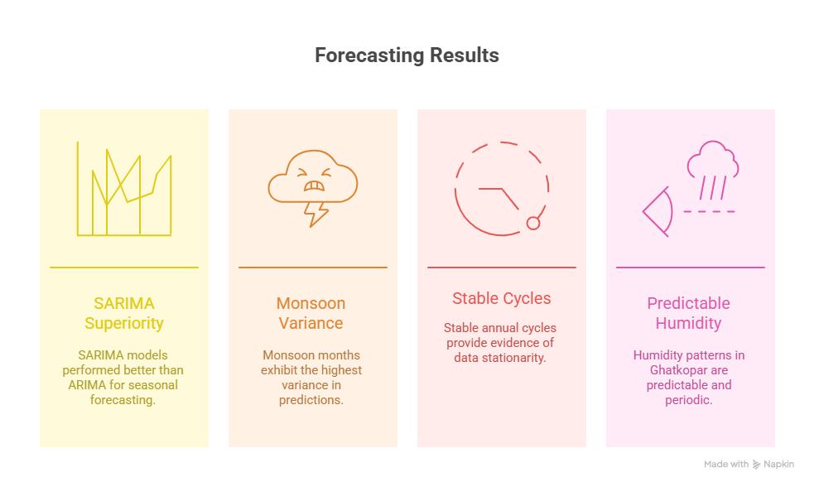
Key Findings

Slide 15
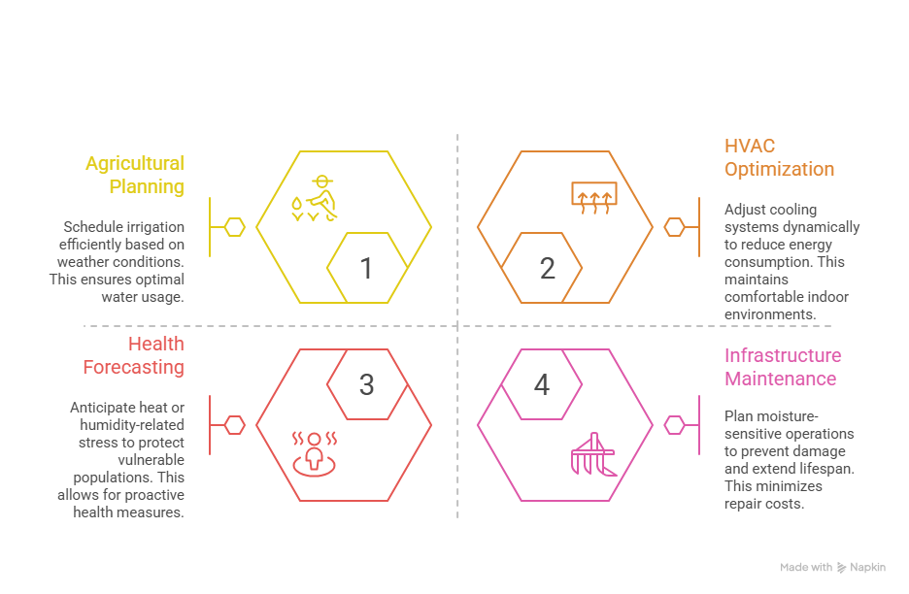
Practical Applications

Slide 16
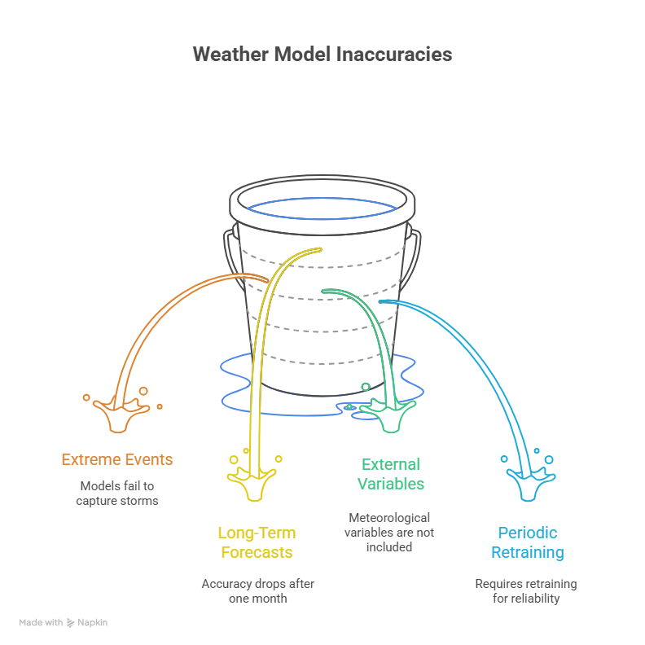
Limitations & Challenges

Slide 17
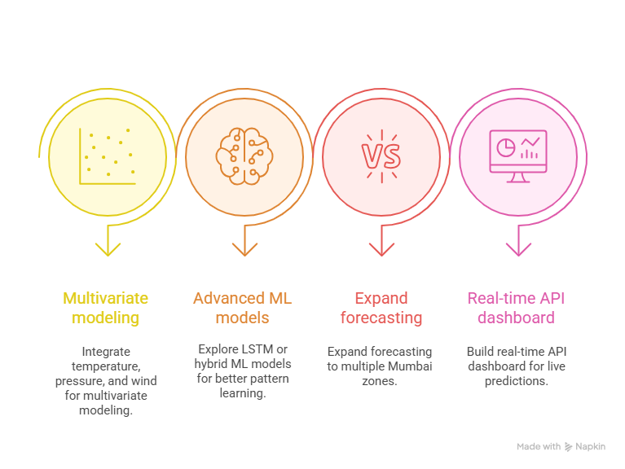
Future Work

Slide 18
References
Open-Meteo Archive API
Historical Weather Data API
URL: https://open-meteo.com/en/docs/historical-weather-api
Accessed: 2023-2024
2. Open-Meteo Documentation
API Parameters and Usage Guidelines
URL: https://open-meteo.com/en/docs
3. Hyndman, R. J., & Athanasopoulos, G. — Forecasting: Principles and Practice
4. Box, G. E. P. et al. — Time Series Analysis: Forecasting and Control
5. Statsmodels, Pandas, Matplotlib, Seaborn documentation
6. India Meteorological Department (IMD) – Climate of Mumbai
7. Stack Overflow Community
Programming Q&A for Time Series Analysis
URL: https://stackoverflow.com/questions/tagged/time-series
8 .Towards Data Science
Articles on ARIMA and SARIMA Implementation
URL: https://towardsdatascience.com/
9 .Kaggle
Time Series Forecasting Tutorials and Competitions
URL: https://www.kaggle.com/learn/time-series

Slide 19
Thank You

